Slide 1

Databases
Relational Algebra
1

Slide 2
Relational Algebra (Relational Operations)
A procedural query language, which takes instances of relations as input and yields instances of relations as output.
A collection of operations that are used to manipulate queries from relations.
Restriction
Projection
Union
Intersection
Difference
Product
Join
Division

Slide 3
Restriction
Returns a subset of rows in a table that satisfy a particular condition.
Syntax
σ<selection condition> (<relation name>)

Slide 4
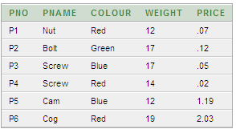
Example
σCOLOUR='Red’(Product)

Slide 5
SQL Restriction
σCOLOUR='Red’^{(Product)}
SELECT *
FROM Product
WHERE colour = 'Red’

Slide 6
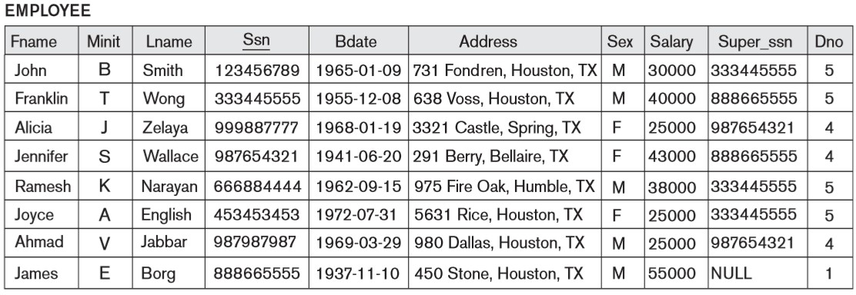
Display the details of employees working in department 5.
σ_{Dno=5} (Employee)
SELECT *
FROM Employee WHERE Dno = 5

Slide 7
σ Sex=M (Employee)
Exercises
σ(Salary>30000 and Sex=F) (Employee)
σ(dno=4 and salary>25000) or (Employee)
(dno=5 and salary>30000)

Slide 8
Projection
Select certain fields from the table and discard the other fields.
Syntax
Π<attribute list> (<relation name>)

Slide 9
Example
ΠPNAME,PRICE(Product)

Slide 10
SQL Projection
ΠPNAME,PRICE(Product)
SELECT pname, price FROM Product

Slide 11
Example
List names of all red colour products

Slide 12
SQL
ΠPNAME(σCOLOUR='Red'(Product))
SELECT pname FROM Product
WHERE colour = 'Red'

Slide 13
Display ssn & name of employees working in department 5.
Πssn,Fname,Minit,Lname(σDno=5(Employee))
SELECT ssn, Fname, Minit, Lname FROM Employee
WHERE Dno = 5

Slide 14

UNION
The result of this operation is a relation that includes all
tuples that are either in A or in B or in both.
Duplicate tuples are eliminated.
A ∪ B

Slide 15
UNION
Used to combine data from one or more tables into new rows.
Columns aren’t combined to create results, rows are combined.
The rows are in the same result.
Data from the first table is in one set of rows, and the data from the second table in another set.
Typically used where you have two results whose rows you want to include in the same result set.

Slide 16
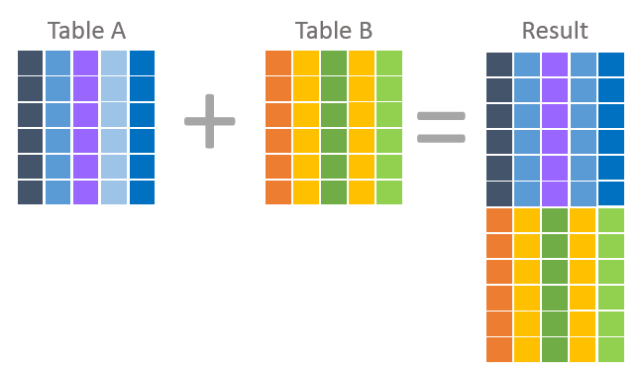
UNION

Slide 17
UNION
Requirements to apply UNION:
The number of columns must be the same for both select statements.
The columns, in order, must be of the same data type.
When rows are combined duplicate rows are eliminated.
use the ALL keyword to keep all rows from both select statement’s results.

Slide 18

Intersection
The result of this operation is a relation that includes all tuples that are in both A and B.
Duplicate tuples are eliminated.
A ∩ B

Slide 19


Difference
The result of this operation is a relation that includes all tuples that are in R but not in S (R –S).
A - B B - A

Slide 20
Example
A =
SNo | FName
S1 | Susan
S2 | Ramesh
S3 | Johny
S4 | Jimmy
B =
ENo | FName
E1 | John
S1 | Susan
E2 | Francis
S4 | Jimmy
Union (A ∪ B) Intersection (A ∩ B) Difference (A-B) Difference (B-A)
-
-
-
-
S1, S2, S3, S4, E1, E2 S1, S4
S2, S3 E1, E2

Slide 21
SQL
SELECT * FROM A UNION
SELECT * FROM B
SELECT * FROM A INTERSECT SELECT * FROM B
SELECT * FROM A MINUS
SELECT * FROM B
SELECT * FROM B MINUS
SELECT * FROM A

Slide 22
Exercise
EmpID | Name | Date Joined | Salary | DeptNo | Designation
E1 | John | 10/10/2013 | 75,000 | D1 | Executive
E2 | Peter | 01/04/2014 | 90,000 | D2 | Manager
E3 | Ann | 15/06/2014 | 85,000 | D1 | Manager
E4 | Tom | 28/01/2015 | 38,000 | D3 | Cashier
E5 | Jimmy | 06/12/2016 | 60,000 | D1 | Executive

Slide 23
Exercise
Query A: Retrieve EmpID and Name of all Employees who are working in Department 1 from Employee table
Query B: Retrieve EmpID and Name of all Managers from Employee table
Find the following:
A ∪ B A ∩ B A – B
B – A

Slide 24
Join
Combines rows from two or more tables when common field(s) satisfies a condition.
P _{θ} SP
equivalent to σ_{θ}(P × SP)
Common columns are usually in a primary key - foreign key relationship (PK-FK)

Slide 25
JOIN
Used to combine columns from different tables into new columns in a single result set.
Data from the first table is shown in one set of columns alongside the second table’s column in the same row.
Each row in the result set contains columns from BOTH table tables.
Rows are created when columns from one table match
columns from another.
The foreign key in one table to look up column values by using the primary key in another.

Slide 26
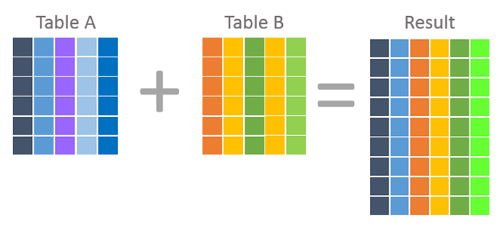
JOIN

Slide 27
SQL Equijoin
Performs a JOIN against equality or matching column(s) values of the associated tables.
An equal sign (=) is used as comparison operator in the where clause to refer equality.
Emp
Emp.DeptID=Dept.DeptID ^{Dept}

Slide 28
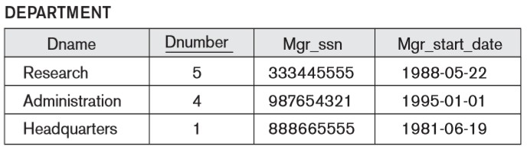

Slide 29
SQL Equijoin
Employee
Dno=Dnumber ^{Department}
SELECT *
FROM Employee, Department WHERE Dno = Dnumber

Slide 30
SQL Equijoin
Employee
Dno=Dnumber ^{Department}
SELECT *
FROM Employee JOIN Department ON Dno = Dnumber

Slide 31
SQL Natural Join
A type of EQUI JOIN and is structured in such a way that, columns with the same name of associated tables will appear once only.
Guidelines
The associated tables have one or more pairs of identically named columns.
The columns must be the same data type.
Don’t use ON clause in a natural join.

Slide 32
SQL Natural Join
Both fields should have the same name and data type.
Employee
Department
SELECT *
FROM Employee
NATURAL JOIN Department

Slide 33
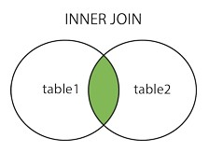
INNER JOIN
Returns all rows from participating tables where the join condition is met.
Displays only the rows that have a match in both the joined tables.

Slide 34
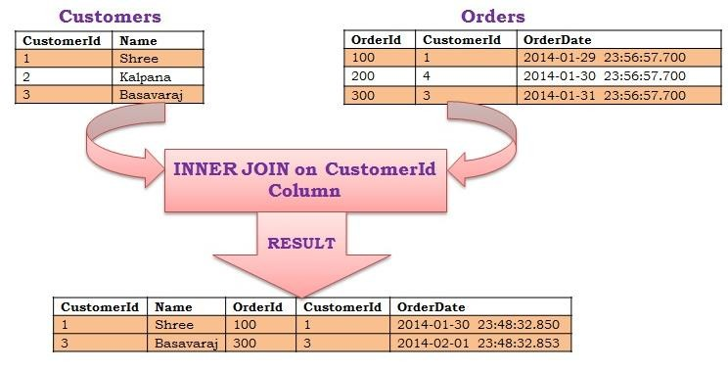
SELECT *
FROM Customers AS C INNER JOIN Orders AS O
ON C.CustomerId = O.CustomerId
SELECT *
FROM Customers AS C JOIN Orders AS O
ON C.CustomerId = O.CustomerId

Slide 35
OUTER JOIN
Returns all rows from both the participating tables which satisfy the join condition along with rows which do not satisfy the join condition.
Where join condition value is not present in the second table, results table padded out with null values.
LEFT JOIN
RIGHT JOIN
FULL JOIN

Slide 36
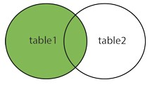
LEFT OUTER JOIN
Return all rows from the left table, and the matched rows from the right table.
The result is NULL in the right side when there is no match.
P
P.PNO=SP.PNO^{SP}

Slide 37
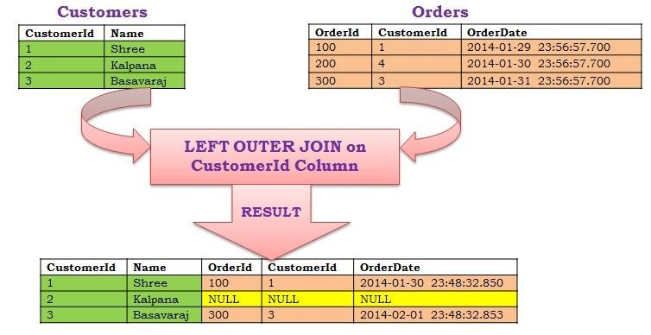
SELECT *
FROM Customers AS C
LEFT OUTER JOIN Orders AS O
ON C.CustomerId = O.CustomerId

Slide 38
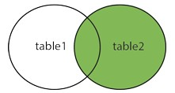

RIGHT OUTER JOIN
Return all rows from the right table, and the matched rows from the left table.
The result is NULL in the left side when there is no match.
P
P.PNO=SP.PNO^{SP}

Slide 39
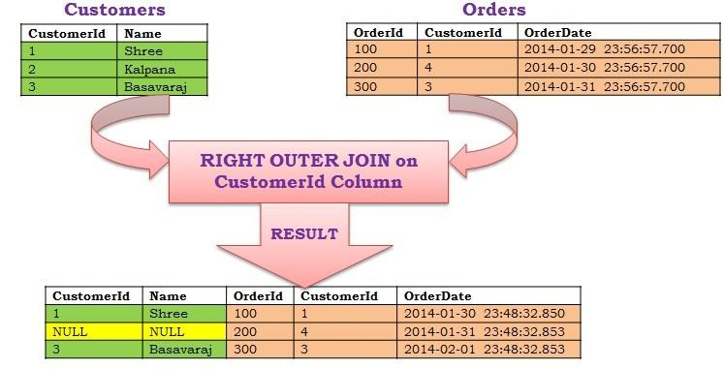
SELECT *
FROM Customers AS C
RIGHT OUTER JOIN Orders AS O
ON C.CustomerId = O.CustomerId

Slide 40
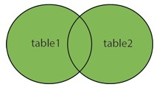

FULL OUTER JOIN
Return all rows when there is a match in ONE of the tables.
Returns all the rows from both tables whether it has been matched or not.
Combines the result of both LEFT and RIGHT joins.
P
P.PNO=SP.PNO^{SP}

Slide 41
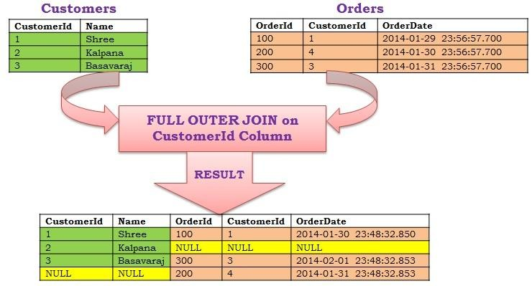
SELECT *
FROM Customers AS C
FULL OUTER JOIN Orders AS O
ON C.CustomerId = O.CustomerId

Slide 42
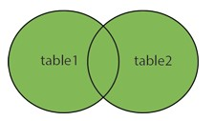
SELECT * FROM Customers AS C LEFT OUTER JOIN Orders AS O
ON C.CustomerId = O.CustomerId UNION
SELECT * FROM Customers ASC RIGHT OUTER JOIN Orders AS O
ON C.CustomerId = O.CustomerId

Slide 43
SELF JOIN
A table is joined to itself (Unary relationships), especially when the table has a foreign key which references its own primary key.
Can be viewed as a join of two copies of the same table.
Self join is used to retrieve the records having some relation or similarity with other records in the same table.
Used where the same table needs to be visited twice.

Slide 44

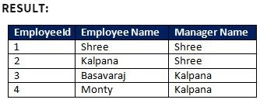
If we need to get the name of the Employee and his Manager name for each employee in the Employee Table.

Slide 45
SELF JOIN
E
E.ManagerID=M.EmployeeID ^{M}
SELECT E.EmployeeId, E.Name AS 'Employee Name', M.Name AS ‘Manager Name'
FROM Employee AS E JOIN Employee AS M
ON E.ManagerId = M.EmployeeId

Slide 46
Product
Returns all possible combinations of rows from two tables.
Produces Cartesian product of the tables that are involved in the join.
The size of a Cartesian product is the number of the rows in the first table multiplied by the number of rows in the second table.
A X B

Slide 47
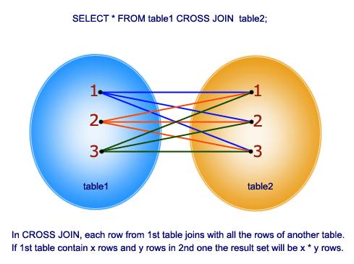

Slide 48
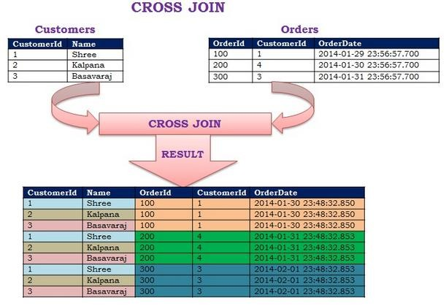
SELECT *
FROM Customers CROSS JOIN Orders

Slide 49
DIVISION
Returns dividend rows that relate to all specified rows in divisor table.
A ÷ B
Z = no of tuples in relation A X = no of tuples in relation B and X < Z
For a tuple ‘t’ to appear in the result of the division, the value in ‘t’ must appear in ‘A’ in combination with every tuple in ‘B’.

Slide 50

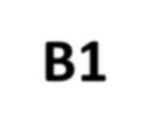
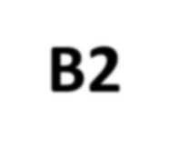
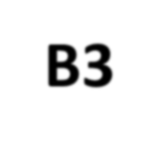
A
B1
B2
B3
SNO | PNO
S1 | P1
S1 | P2
S1 | P3
S1 | P4
S2 | P1
S2 | P2
S3 | P2
S4 | P2
S4 | P4
PNO
P2
PNO
P2
P4
PNO
P1
P2
P4
A/B1
A/B2
A/B3
SNO
S1
S2
S3
S4
SNO
S1
S4
SNO
S1

Slide 51



Example
A
B
÷
=
"Which supplier(s) supplies ALL
products?"

Slide 52
SQL Division
SELECT Sno FROM A A1
WHERE NOT EXISTS (SELECT *
FROM B
WHERE NOT EXISTS (SELECT *
FROM A A2
WHERE A1.Sno = A2.Sno AND A2.Pno = B.Pno))

Slide 53
Thank You
53

